Slide 1
History of Indian Science
Dr P. Priyadarshi
MBBS, MD, FRCP (UK)

Slide 2
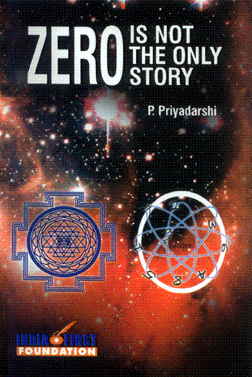
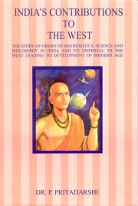
1. India’s Contributions to the West (2004) 2. Zero is not the Only Story: Ancient Indian Contributions to Modern Sciences (2007)

Slide 3
Some Incredible Achievements of Ancient Indian Scientists
Velocity of Light
3,00,000 kms
Sayana Bhashya of the Rig-Veda, I.50.4.
Also quoted by
G.V. Raghavrao
Dr H. C. Varma
P. Priyadarshi (2004)

Slide 4
The Big Bang Theory
The Nasadiya Sutra of the Rig-Veda
(Rig-Veda 10.129)
That this and other Vedic descriptions of creation are a “Big Bang” theory has been accepted after proper examination of the texts.
(See Priyadarshi 2007; Capra, 1991, The Tao of Physics; Teresi, 2002, The Lost Discoveries)

Slide 5
Vedic Astronomy
It is generally held by the historians that the concept of the heliocentric solar system was invented by the ancient Greeks, and that the division of the heavens or sphere into 360 part and the 12 signs of zodiac were borrowed by the Indians from the Babylonians.

Slide 6
Dirgha-tama Sukta, RV, 1.164.48
“Twelve spokes, one wheel, navels three.
Who can comprehend this?
On it are placed together
three hundred and sixty like shanku (cones, angles).
They shake not in the least.” RV 1.64.48
The three axes are clearly: diurnal, annual and precission.
RV 1.164.2 also mentions “three naved wheel”.

Slide 7
Zodiac sign
“Formed with twelve spokes, by length of time, unweakened, rolls round the heaven this wheel (cycle) of orderly existence. Herein established, joined in pairs together, seven hundred and twenty sons, O Agni.”
Rig Veda 1.164.11;

Slide 8
Heliocentric Solar System
It is explicit in the Chandogya Upanishad that the Sun is the “madhye-sthata” lying at the centre.
Ch. U. 3.11.1
Also,

Slide 9
Moon lighted by Sun’s Light
"The moon gets light from the ray of the sun named Susumna”.
Shukla- Yajurveda Samhita 18.40.
Chaukhamba Vidya Bhavan, Varanasi, 1996. p.456.
Also, Taittiriya Samhita (Krishna Yajurveda), 3.4.7.1.

Slide 10
Such views about moon had survived at least until about 1000 AD
Al-Biruni, a Muslim traveller and historian from about 1000 AD noted that
the Hindus believed
“when the solar ray meets the moon, the ray becomes as cool as moon herself, then, being reflected, it illuminates the darkness, makes the night cool and extinguishes any hurtful kind of combustion wrought by the sun.

Slide 11
It is important to accept the incredible mature of these views. Because people outside India believed that sun and moon are lighted objects placed by God to are arrangements

Slide 12
Current available evidence shows that India was the world leader of science from the earliest times (Vedic Period) until the twelfth century. Bhaskaracharya II was the best mathematician and astronomer world over in the twelfth century.
By the end of the twelfth century, Indian universities at Nalanda, Vikramashila and Odantpuri were destroyed by Bakhtiyar Khilji, propelling India into a Dark Age of ignorance.

Slide 13
However, some mathematicians and scientists fled to the South, where they continued to flourish as the South or Kerala school of Indian mathematics. Nilakantha, Mahadeva etc are mathematicians from that school of Kerala.
It has been found that much of what Newton is credited for, and many of the European mathematical discoveries were actually brought to Europe as the translations of the works of the scholars of the Kerala school, and also the earlier Indian scholars like Bhaskara, Aryabhata and Brahmagupta.
(George Ghevergese Joseph, The Crest of the Peacock: Non-European roots of mathematics, Princeton University Press)

Slide 14
The Sulba Sutras
Pythagoras in the sixth century BCE came to India, where he learned Indian mathematics and then went back to Greece to establish the first mathematical tradition of Europe.
The Baudhayana Sulba Sutra of the Vedic text Katyayana Kalpa Sutra is known to us today as the Pythagoras’s Theorem.

Slide 15
Early Mathematics
Any mathematics textbook from Vedic times has not survived till today. Yet from the stray mentions, we are able to arrive at an evidence based conclusion that the decimal system of numbering, geometry etc were present during the Vedic Age itself.
We will not go into the details of Vedic Age mathematics.

Slide 16
Kanada’s Vaishesika Sutra
The only surviving textbook of physics from 6th century BCE

Slide 17
KANADA’S VAISHESHIKA SUTRA
PERIOD: SIXTH CENTURY BC
A COMPREHENSIVE TEXTBOOK OF PHYSICS
DISCUSESSES:
MECHANICS
HYDRAULICS
ELECTRICITY
HEAT
LIGHT
MENTIONS MAGNET
QUANTUM, ATOM AMD SPACE
PHYSICAL CHEMISTRY

Slide 18
Anti-matter
Mentioned by Kanada as “abhava-padartha”
Today we can say that abhava-padartha of Kanada is nothing but anti-matter.

Slide 19
Anti-Matter
“Tadabhave samyogabhvopradurbhavashcha mokshah.”
Tad abhave samyoga bhavo pradurbhavah cha mokshah.
The union of bhava matter and abhava matter leads to annihilation of (both).
Vaisheshika darshanam, 5.2.18

Slide 20
Kanada mentions magnet too
“Mani-gamanam suchi-abhisarpanam-adrishta-karanam”.
(When the magnet moves, the suchi also moves; this is due to invisible cause.)
Vaisheshika Sutra, 5.1.15
Linguistic analysis shows: suchaka = indicator derived from “suchi” (needle) why?

Slide 21
Magnetic compass mentioned in 9th century
Adi Shankaracharya (9th century AD) too mentioned magnet and compass “bhraamakasya lauha bhramanena”.
(Sri Madbhagavad-Gita, 18.66 commentary 66.12)
He uses the word bhraamaka.
Bhraamaka literally means “one which aids in bhramana”.

Slide 22
We will today examine some sutras discussing mechanics
One substance changes into other substance, and its properties change into other properties. (Vaisheshika sutra, 1.1.10)
This is Law of Conservation of matter and energy. (First Law of Thermodynamics)
The First Law of Thermodynamics is stated at many places in ancient literature. One is Bhagvad-Gita 2.16, other is Chhandogya Upanishad 6.2.2. kathamasad-sajjayet

Slide 23
One karma (energy) is not produced by other Karma (energy). [karma karma saadhyam na vidyate] (Vaisheshika-Sutra, 1.1.11)
Here Acharya postulates, that one karma (energy) cannot produce another karma (energy) [directly, without intervening work].
Only a modern physicist can judge how far he was correct.

Slide 24
Karya-virodhi-karma. Energy is against the work. (Vaisheshika-Sutra, 1.1.14)
In other words, the accumulated karma (potential energy) is exhausted by same amount of work in the opposite direction.
Another meaning is :
Work done = Energy Required; And the diction is opposite.

Slide 25
An example of systematic disposition of a topic by Kanada
Vaisheshika Sutra: Ch. 5.
It discusses primarily physics involved in the process of milling (pounding).
Energy, elasticity, collision

Slide 26
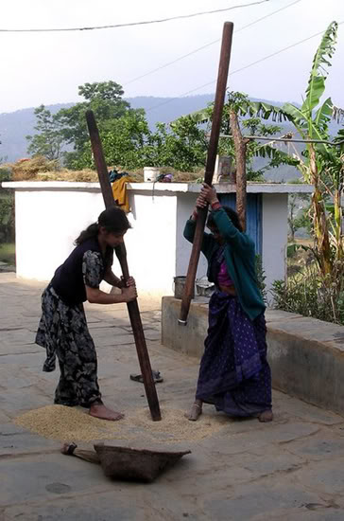
Active and passive work, gravity and collision (elastic) have been discussed in Chapter 5 of the Vaisheshika Sutra

Slide 27
Vaisheshika Sutra, 5.1.1
The self causes the ‘hand’ to move up.
This is the first cause of initiation of the milling process.

Slide 28
Effort by hand (lifting) produces karma in the musal. (Vaisheshika-Sutra, 5.1.2)
At this point, we do not know whether karma means kinetic energy or upward momentum.

Slide 29
When the musal falls back on the ukhala (base), hand is not working. (Vaisheshika-Sutra, 5.1.3)
Here it has been explained to the student, by means of a suitable example, that for doing a work, one needs to apply force. Hand is not applying any force hence not working. In this case actually gravity is doing the work.

Slide 30
When the musal rebounds upwards after hitting the ukhala, there is no effort by hand. (Vaisheshika-Sutra, 5.1.4)
Here Kanada gives an example of a perfectly elastic collision in vertical line.

Slide 31
When the hand holds the rebounding musal, a karma is generated in the hand due to contact with the musal. (Vaisheshika-Sutra,5.1.5)
The sutra-kara understands that ‘hand’ is not active in upward movement, yet it has developed a velocity. Hence a karma develops in it. Thus we get that karma is a function of ‘velocity’ in this case. But it is not clear as yet from the text whether it is momentum or energy.

Slide 32
In this way, karma generated in hand may be either due to the hand’s link with the self, or due to its link with an object. (Vaisheshika-Sutra, 5.1.6). Author means to say that a physical contact is essential for transfer of ‘karma’.
This sutra explains that karma can be transferred in anything only because of a link between it and something else for transmission.

Slide 33
Then he mentions exceptions: The invisible forces:
Like the ascent of sap in a plant against gravity. Vaisheshika Sutra, 5.2.7
Ascent of vapor in sky appears to be because of invisible cause, yet actually it is because of sun-rays causing negative and positive pressures in air. (Vaisheshika Sutra, 5.5.5-6).
Gravitation
Magnetism
The purpose of the author here is to explain that often the cause may not be obvious, and one may think the cause to be non-existent, but even in there the cause exists.

Slide 34
Coming back to musal, Kanada says: If the hold is lost, object falls because of gravity. (Vaisheshika-Sutra, 5.1.7)
The sutra explains here that hold ‘opposes gravity’. If there is nothing to oppose the force of gravity, “gravity causes” the fall (gurutvaat patanam).

Slide 35
Kanada claims this to be universally applicable, even for the water in the clouds.
Vaisheshika Sutra. 5.2.3 says
“apam samyogabhave gurutvat patanam” in context of cloud and rain.

Slide 36
Back to musal: (Anything) cannot move upwards unless there is (applied) a critical nodana. (Vaisheshika-Sutra, 5.1.8)
This concept of ‘critical force’ just after the sutra discussing ‘gravity’ is significant. It hints that gravity (m.a or m.g) is a particular force, and any force less than that will not cause an upward motion.

Slide 37
Then Kanada gives relationship between nodana and effort: A particular prayatna (effort, force) produces a particular nodan (?momentum). (Vaisheshika-Sutra, 5.1.9)
Nodan is ‘impulse’. (Monier-Williams Dictionary). Which means change of momentum.
Hence we can say that ‘change of momentum is proportional to the force applied.’

Slide 38
A particular nodan (?momentum) produces a particular rise (of projectile). (Vaisheshika-Sutra, 5.1.10)
This reminds me of H = v²/2g;

Slide 39
When the hand (holding musal) falls freely (with the musal), it is doing a dara-karma or ladies act (passive work). (Vaisheshika-Sutra, 5.1.11)
This gives the definition of passive-karma. Passive karma is that karma when force is applied by something else and the motion and force both are in the same direction, as in the case of hand-musal combine.

Slide 40
Thus the Vaisheshikas understood that work, kinetic energy and potential energy are only different stages or forms of the same thing.

Slide 41
Spiritual samskara
Samskara is ‘action’ done on to someone in the past. It includes ‘impacts’ of past violence.

Slide 42
Correlation with spiritual karma
Karma is ‘accumulated work’ of past actions/ efforts.
It cannot be destroyed.
It has to produce a certain amount of work/fruit, before it can be exhausted.

Slide 43
Rate of change of sanskara with height in a vertically thrown projectile (dǿ/dh)
Nodnat-aadyam-ishoh karma tat-karmakaaritaat-cha samsakarat-uttaram tathottaramuttaram cha. Vaisheshika-Sutra, 5.1.17
Samsakaara-abhaave gurutvaat patanam. Vaisheshika-Sutra, 5.1.18
Meaning: Initially the impulse (nodana) applied to the projectile produces karma (?kinetic energy) in the projectile. As the projectile rises, higher and higher samsakara (energy stored) is used. When the samsakara of the projectile is exhausted, it starts falling down under the influence of gravity.

Slide 44
Prashastapada says that samskara is of three types viz. vega, bhaavana (impression) and sthitistapaka (form-restoring)
Samsakara Prakaranam in the Prashastapada Bhashyam, Hindi Tr. op. cit. p. 221-3.

Slide 45
Knowledge of Vector in ancient Indian Physics
Dig-vishishta (karma-padartha-nirupanam Prakaranam) and
niyat-dig-kriya-vishishta (samsakara prakaranam) of the Prashastapaada Bhashya

Slide 46
Break for two minutes allowing a few questions

Slide 47
Rediscovering Indian Past

Slide 48
By the time the British came in power in India, India had lost nearly all memory of her pre-Medieval past. Whatever was available comprised only of folklores and some legends contained in the religious texts like the Puranas and the Mahabharata.
Thus in the nineteenth century, Chandragupta Maurya, Kautilya’s Arthashastra etc were not known to anyone.

Slide 49
The British took the task of unearthing India’s ancient past.
However, there was resistance from Western minds to accepting any great achievement to the ancient Indians.

Slide 50
The Discovering of Indian past
When it became obvious in the twentieth century that the “zero” was invented in India, many Eurocentric scholars staked claims that the “zero” had been invented by the Greeks from the Greek letter ‘omicron’.
However, when an inscription dating back to 585 AD was found in Gujarat with numeric “zero” in it, everyone had to agree. (Basham:495; Duncan:166;)

Slide 51
By now it has been known to the historians that the modern number system and the ten numerals were invented in India, yet the name of the numerals as the “Arabic Numerals” stays in vogue. They should be called the “International Form of the Indian Numerals” as named in the Constitution of India (Art. 343-1 ), or simply the “Indian Numerals”.

Slide 52
Pingala
Even the binary number system used in computer science was invented in India.
(Pingala, chhandah-sutra, 8.24-25)
Pingala’s book also discusses Permutation and Combination

Slide 53
Panini (600 years before Christ) gave the language theory, which became basis for modern compute language: Backus-Naur form language. It has been renamed as Panini-Backus form.

Slide 54
Has Modern Science derived from transmission from India

Slide 55
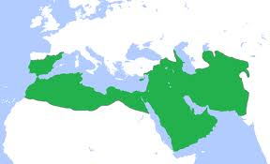
Story of Kanaka
The Indian province of Sind was under Arab rule. A diplomatic delegate from Sind went to the Caliph’s court in Bagdad in 771 AD. The delegate had included an Indian scientist Kanaka,
Called al-Kanakah al-Hindi by al-Qifti.

Slide 56
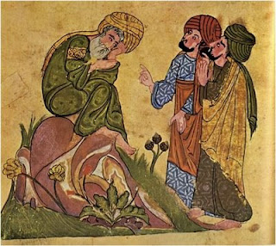
Kanaka had taken with him a large number of Sanskrit books discussing Indian science. He presented and explained them to the Caliph al Mansur.
Caliph got amazed by science of India. He ordered translation of the texts into Arabic.

Slide 57
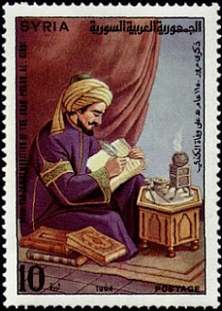
Al-Fazari and Yaqub-ibn-Tariq
Caliph appointed these two Arabic scholars, al-Fazari and Yaqub-ibn-tariq to become students of Kanaka, to learn Sanskrit and to translate all the Sanskrit texts into Arabic.
Fig. Commemorative stamp on Al-Fazari

Slide 58
The most important texts were
Books of Aryabhata
Books of Brahmagupta

Slide 59
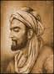
The Library Bait-al-Hikma (House of Knowledge)
To house and preserve these texts, Caliph al-Mamun ordered founding of a library at Bagdad, which was completed in 833. It functioned like a university.
All the Arabic version of Indian books were kept here.

Slide 60
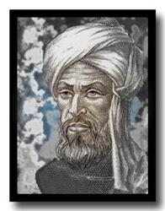
Al Khwarizimi
Al-Khwarizimi appointed head of the library and mision for knowledge.
He visited India twice to take more books to Bagdad.
Later al-Khwarizimi synthesized the entire knowledge to compile a book of mathematics and science.

Slide 61
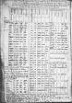
The book compiled by al-Khwarizimi was named “SIND-HIND” which is a corrupted version of “siddhanta”.
It became the main text book of maths and science in Europe later.

Slide 62
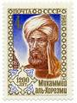
Al-Kwarizimi
Al-kwarizimi wrote another text book , which is not available today, but its translation into Latin served as the main light of Europe. This book was called in Europe “Algoritimi de numero Indorum” (Al-Khwarizmi on Indian numbers).

Slide 63
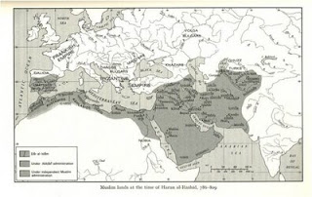
Knowledge moves West: Library at Cordoba
Caliph Abd-ar-Rahman III (891-961) got a huge library constructed in Spain at Cordoba,
and started the work of translating Indian science texts, available as Arabic, into Latin for use by the Europeans.

Slide 64
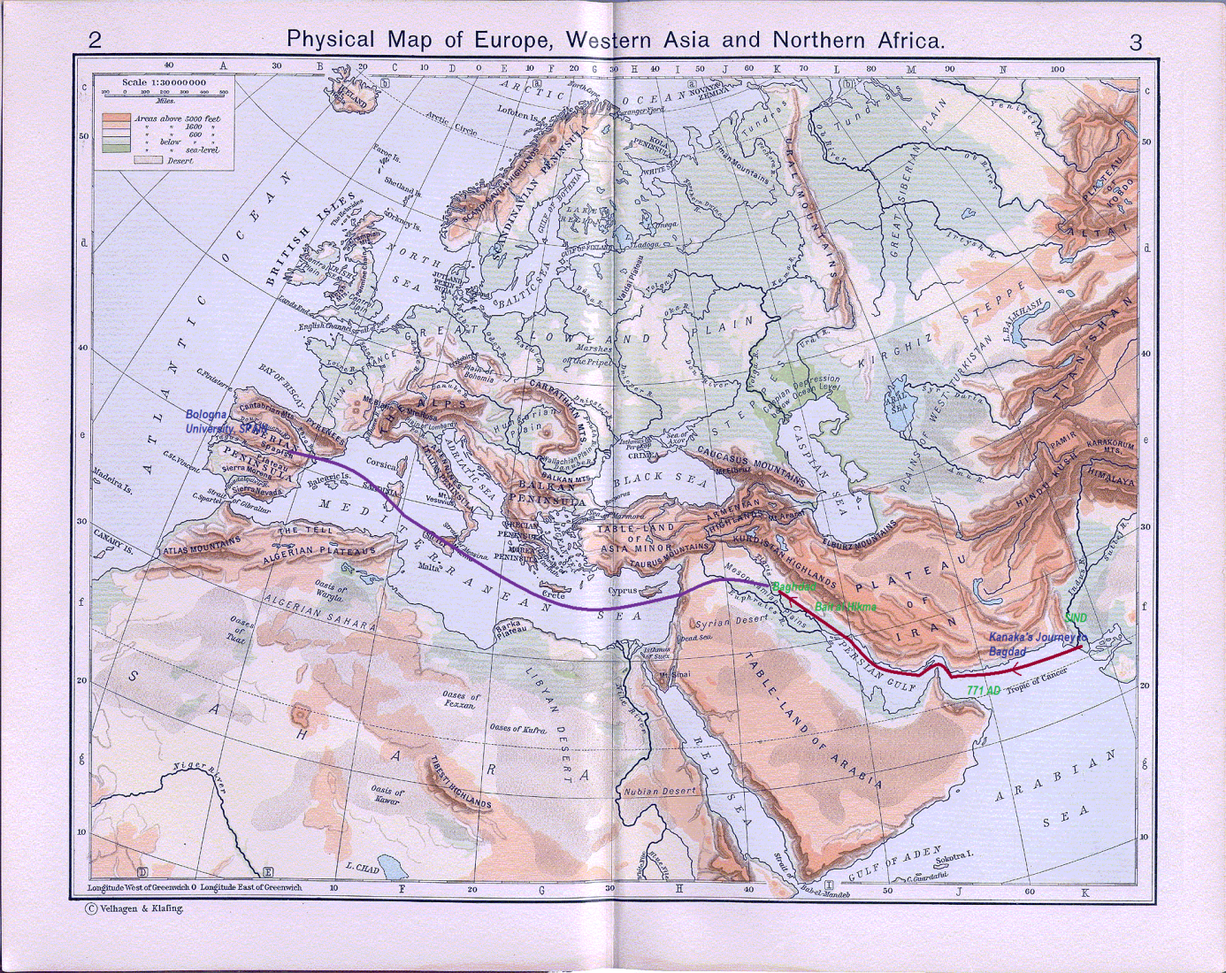
The Journey of Indian Science

Slide 65
Translations continued in Europe until 1600
More such libraries-cum-universities were opened in Europe:
Naples
Paris
Bologna (Where Copernicus studied later).

Slide 66
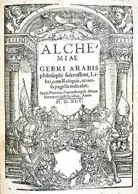
Algebra
Al-Khwarizimi also translated the Indian books on Bij-Ganita (algebra) and compiled them as a text.
This was translated into Latin by Geraldus Cremonensis as
“Liber Maumeti filli Moysi Alchorismi de algebra et al muchabala”.

Slide 67
Did We Come from outside

Slide 68
DNA studies of Homo sapiens sapiens origin
1987: Cann and Stoneking
1988: Stinger and Andrews
Proposed “Out of Africa”

Slide 69
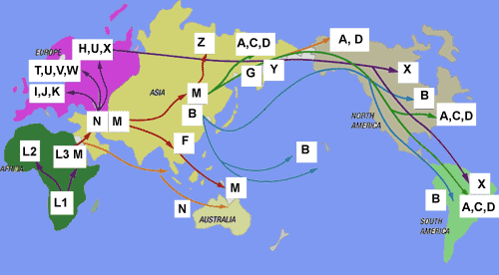
Homo sapiens sapiens originated 160,000 BP in East Africa. It was thought that man came out of Africa by Egypt-Suez-West Asia route.

Slide 70
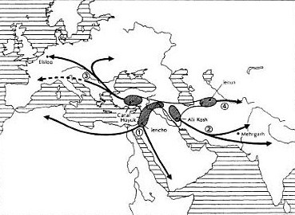
Renfrew, 1990. Farming/language dispersal Hypothesis. 1=Afro-Asiatic; 2=Elamo-Dravidian; 3=Aryan; 4=Altaic.

Slide 71
But soon the West Asian route was ruled out by further DNA studies
It was found that it was from India that entire surviving non-African Humanity has evolved.
It was assumed that the first Indians came from Africa.
It was further noted that African specific LINEAGES never went out to anywhere (male A, B, and Female L0-L6).
Thus, Indians are Out of Africa, and rest of the world is “Out of India” in the current consensus view.

Slide 72
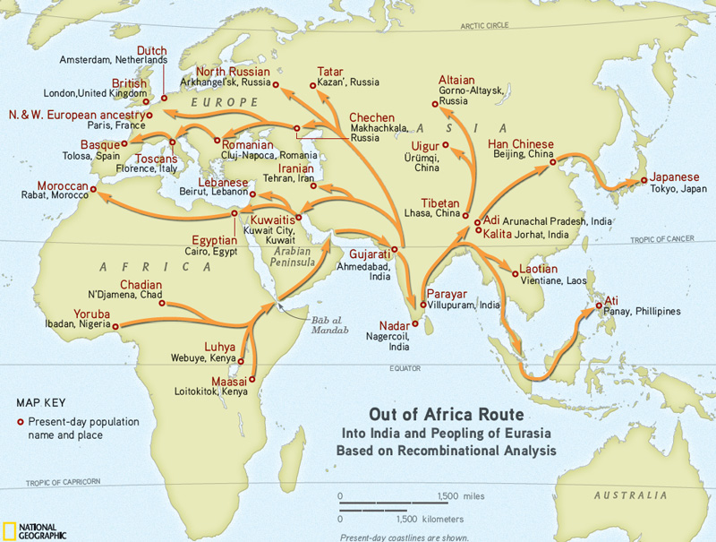
Recombinant DNA study September 2011 Supported by IBM

Slide 73
Migration Maps

Slide 74
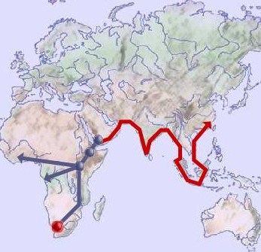
Some men leave Africa
Man left East African horn,
Reached India,
Once only.
100,000 years back (some authors write 70,000 to 60,000 years back).

Slide 75
This population expanded numerically, culturally and linguistically in India over time.

Slide 76
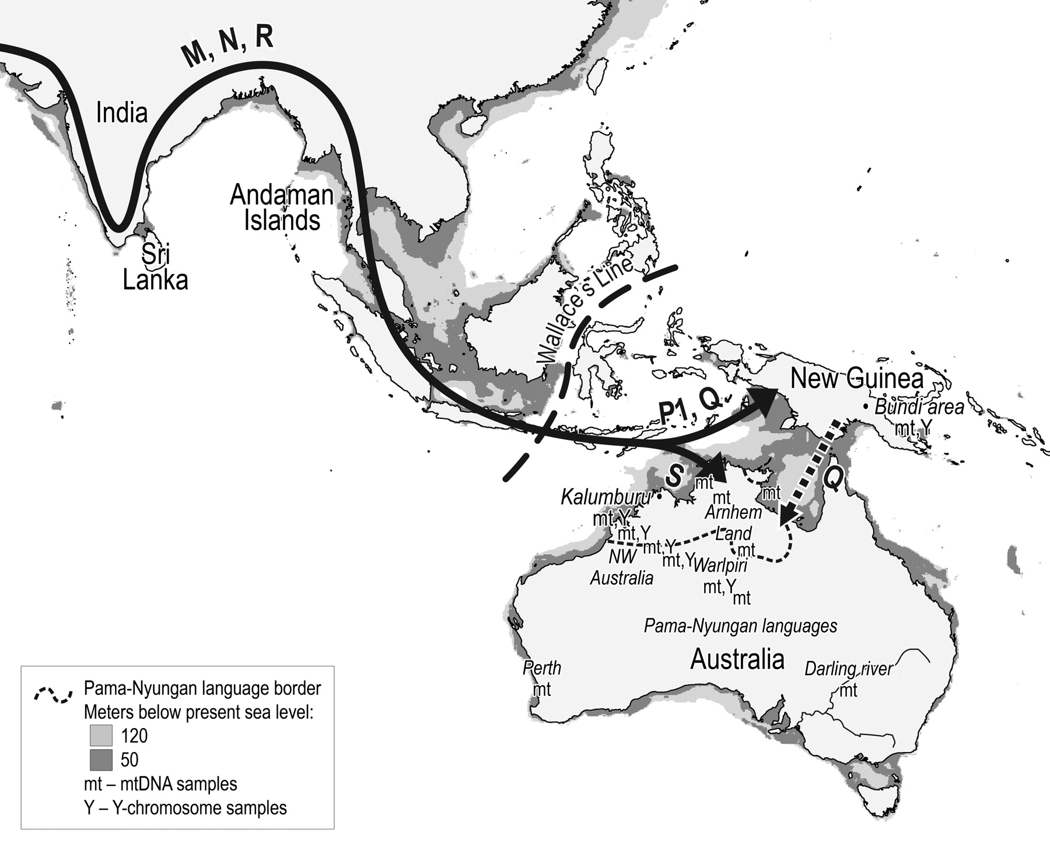
The first journey out of India started 85,000 years back and reached Australia by 60,000 years B.P. Hudjasove, 2007

Slide 77
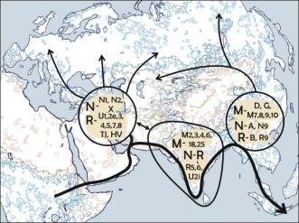
India played a central role in populating the world. All the European, Asian and Amerindian maternal lineages originated from India over time as waves (Fig. Metspalu et al, 2004)

Slide 78
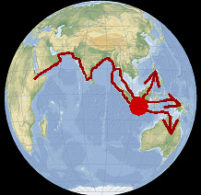
The view is now a consensus and official view. Fig: Natural Environment Research Council, Cambridge, UK.

Slide 79
After first migration to SE Asia, came the worst Glacial Phase (74,000 years back to 65,000 years back)
Human populations survived in India, Southeast Asia and East Africa only.
Estimated figures of survival are 1000 in India, 9000 in Africa and less than 1000 in SE Asia.
Following glacial, all the three human populations expanded. But African one did not migrate out of Africa.

Slide 80
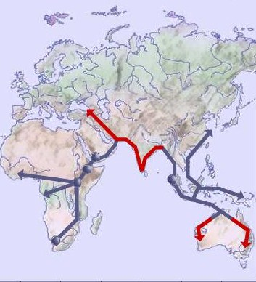
About 60,000 years back, post-glacial population expansion in India led to migration to west.

Slide 81
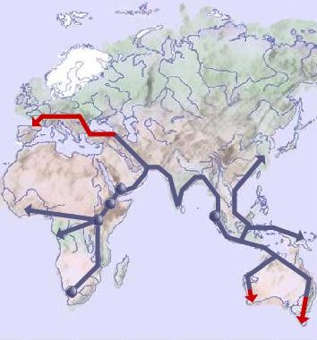
By 52,000 years before present:

Slide 82
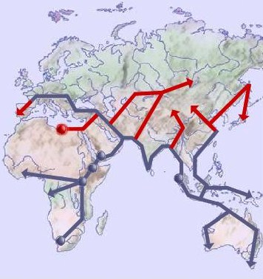
40,000 b.p.: People enter China from three directions. Two sources originated from India, one from Southeast Asia.

Slide 83
Implications for Linguistics

Slide 84
It was noted that DNA lineages and Language families overlapped exactly
Cavalli-Sforza, L.L. et al, Reconstruction of human evolution: Bringing together genetic, archaeological, and linguistic data, PNAS 1998, 85: 6002-6006.
HUGO pan-Asian SNP Consortium, Mapping Human genetic Diversity in Asia, Science 2009, 326(5959): 1541-1545.

Slide 85
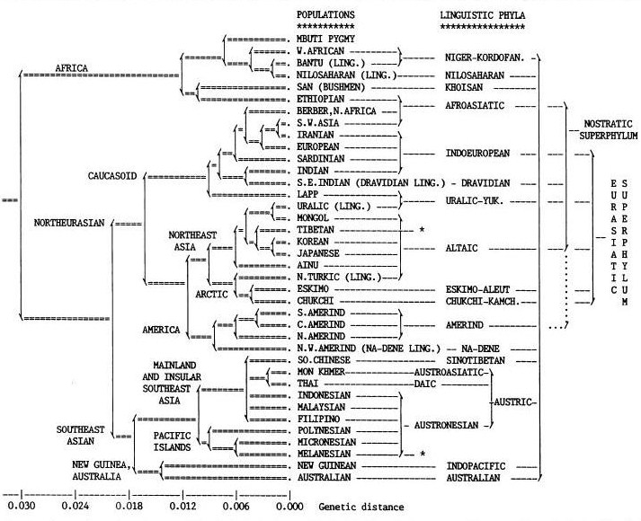
Cavalli-Sforza, 1998; Eurasiatic Super-Family of Language and DNA lineages matched.

Slide 86
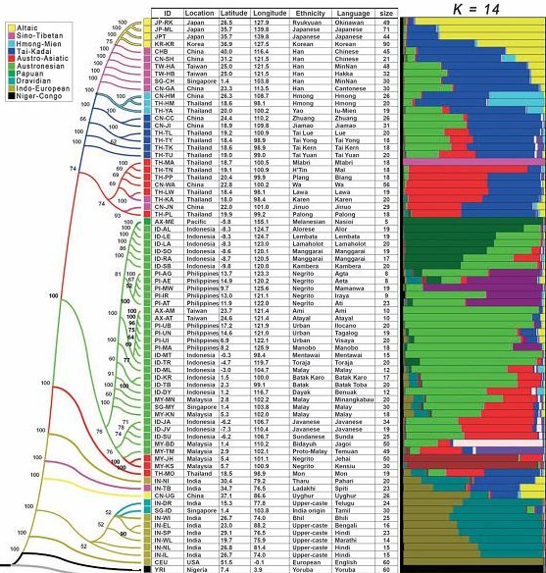
HUGO- similar matching for East half of Asia

Slide 87
Hence we need to see DNA lineage migration and Language family migration together.

Slide 88
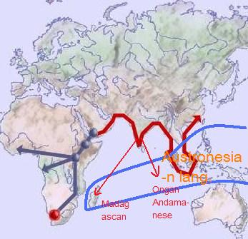
At 85,000 ybp people migrated to Madagascar and Andaman from Mainland India
Maternal lineages from root of ‘M” and Paternal (Y-chromosomal ) C and D were involved.

Slide 89
Austronesian has left substratal remains to modern Indian (and also Sino-Tibetan, Austro-Asiatic and Daic) languages. One such example is word ‘bahin’
bahine (woman, Rapanui, Austronesian l.),
wahine (woman, Maori and Hawaiian),
vahina (woman, Tahitian),
fafine (woman, Samoan)
AND:
bahin (sister, Hindi)
bo-chhin (mother, Chinese Quanzhou, Xiamen, Zhangzhou dialects),

Slide 90
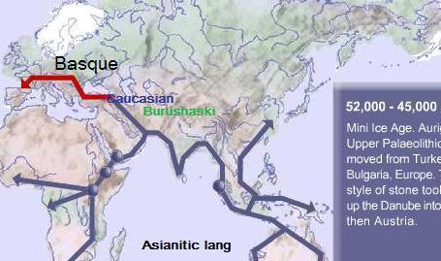
Asianitic Language Super-family migration: 60,000 to 52,000 BP

Slide 91
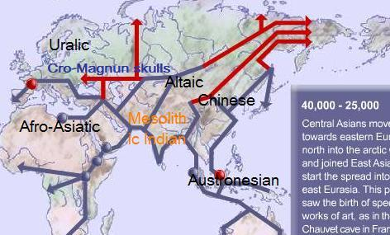

Slide 92
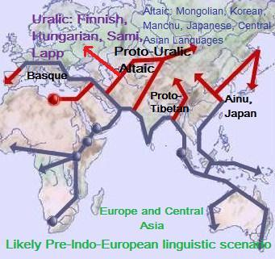
It is now established that Altaic and Uralic languages are one Altaic-Uralic super-family

Slide 93
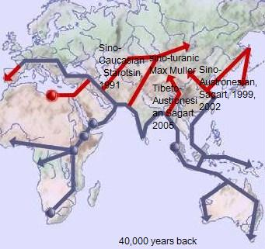
Different views on origin of Chinese language make better sense with understanding of DNA migration

Slide 94
Some examples of such words are
1. Sow (English),
se, seh (PIE, to sow),
si, siu (Munda, to plow),
sA- (Sk. To plow), sitA, sirA (Sanskrit, furrow)
etc.

Slide 95
2. Derived from Sa/ seh
*sehm (PIE, grain),
sasa (Sanskrit; sasam in Rig-Veda),
sasya (Sanskrit, food, seed, grain, herb),
*Sasja (Proto-Celtic)
*sito- and *sitya- (PIE, ‘corn’),
sitiyam (Sanskrit, corn, ploughed),
siri (Khowar, Afghan, barley), and sili (Kalasha, Hindukush, millet).
Selo (Latin, to sow)
Munda family saro, sar (paddy) and Munda and Kharia have –sro and –srA, paddy.
Words sro, sre and sru meaning ‘rice’ in some Khmer (Cambodia) dialects.

Slide 96
3. Mill (E.),
Old English mylen, Latin mola, all meaning millstone; Latin molere to grind. PIE mel / mol / ml to grind.
German muhle and Sanskrit musala (grinder).
Thai language mo:h means ‘mill-stone’ and ‘to grind’.

Slide 97
4. Pestle (E.),
PIE *pis-to,
Sanskrit pis-
5. Pita (colloquial English ‘bread’),
Greek pitta bread, Italian pizza,
Hindi (Bihar, East UP) pittha,
Sanskrit paishta.

Slide 98
6.
Grind (E.),
Old English grindan,
P. Germanic grindanan,
PIE *ghren, *ghreu-, *ghen, (?*grendh-)
Munda guru, Santhal and Kherwa guRgu mean ‘grinding stone’.
Thai gruaam (to grind), gro:hng (mortar), gra- deuuang (stamp-mill, mortar)

Slide 99
Fuller 2008, gives a large list of words used in textile present in Sanskrit and Dravidian/Munda fam. One such example is ‘tantu’
tantu (Sk., fiber), tantra (Sk., loom), tAna (Sk., fiber, tone, tension), tanti and tatamA (Hindi, weaver);
tendon (E.), tentacle (E.) tendril (E.), tent (E.), tenter (E., loom), tenet (E.), Dendron (Gk. fibre);
tonti (Juang, weaver), dendra (Telgu, weaver).
tay (Bonda, to weave), tan (Kharia, to weave).
ten (Santali, to weave),
thai:n (Khasi, to weave).
tor (Thai, to weave), tan (Alak, Lave, Khariya Sura and Niahon, to weave); tana (Nicobarese, to weave),

Slide 100
tUla (Sk., cotton), tUlika (Sk., brush),
tula (Munda-Juang; cotton, feather, hair),
tol (Old Mon; cotton, hair, feather),
tuy (Tamil, cotton),
towel (E.)
This linguistic argument is stronger than ‘horse’ linguistic argument which had said: Cognate of PIE akwa (Sk. Ashva) is found in all the IE languages therefore Aryans must have originated at Central Asian steppes where horse was found in the wild.

Slide 101
Male mediated Y chromosomal DNAs

Slide 102
New Mischief
In this theory, those who went out of India before 35,000 years back, they evolved into many language groups and cultures following LGM.
Then they started invading India as male-alone lineages about 10,000 years back from all directions .

Slide 103
Some authors guessed that all the male lineages of India arrived from outside during Neolithic
Dravidians from West Asia: male lineage J2 and L1, with farming, barley and cattle (Wells, 2001);
Or Africa (Winters) H, K2.
Austro-Asiatic (Munda) came from China (or Southeast Asia): paternal O2a and maternal R7. Or from Africa, maternal lineage M1.
And some claimed that they came from both China and Africa (Basu, 2004; Winters 2009).
Aryans (Y lineage R1a or M17) came from Central Asia with pastoralism and horse (Wells, 2001).

Slide 104
But further studies just broke these conjectures. They say: Austro-Asiatic speakers originated in India.
Chaubey et al (2008) ruled out maternal DNA R7 migration to India from SE Asia and established that this lineage originated in India.
Kivisild (2003) proved that all the inhabitants of India are descendants of original settlers in India, whether of any cast, tribe or linguistic affiliation.
A large number of DNA tests of Indian castes, tribes and linguistic groups repeated the same results and conclusion.

Slide 105
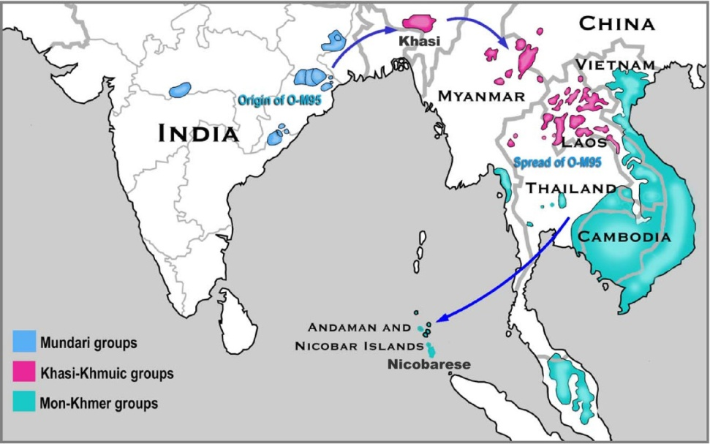
Kumar,Vikrant et al, Y-chromosome evidence suggests a common paternal heritage of Austro-Asiatic populations, BMC Evol Biol 2007, 7: 47.

Slide 106
We have seen that Chinese population came from NE India 40,000 years back
Current Han population is mainly composed of O3 male lineages, which originated in Burma and Northeast India.
Other lineages in China are older C, D; and O2a and O1a.
O3, O2a and O1a are branches of ‘O’ which originated in India.

Slide 107
DNA says--In fact no one migrated from China to even Northeast India. In reality, Chinese originated from Southeast Asia and Northeast India.
1. Bing Su et al, 1999, Y-Chromosome Evidence for a Northward Migration of Modern Humans into Eastern Asia during the Last Ice Age, Am J Hum Genet
2. Hong Shi et al, 2005, Y-Chromosome Evidence of Southern Origin of the East Asian–Specific Haplogroup O3-M122, Am J Hum Genet

Slide 108
Hua Zhong et al 2010: 2 articles
1.Some came to China from India and Tibet: Extended Y-chromosome investigation suggests post-Glacial migrations of modern humans into East Asia via the northern route, Mol Biol Evol.
2. But majority of Chinese emerged from SE Asia: Global distribution of Y-chromosome haplogroup C reveals the prehistoric migration routes of African exodus and early settlement in East Asia, J Hum Genet

Slide 109
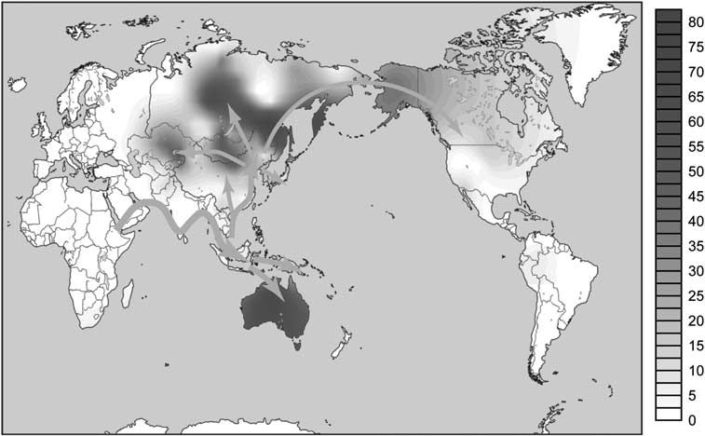
Hua Zhong (2010), with the help of Y Hg C, not only proves that from Africa people came to India, and from India to SE Asia, but also that the Chinese population originated from SE Asia.

Slide 110
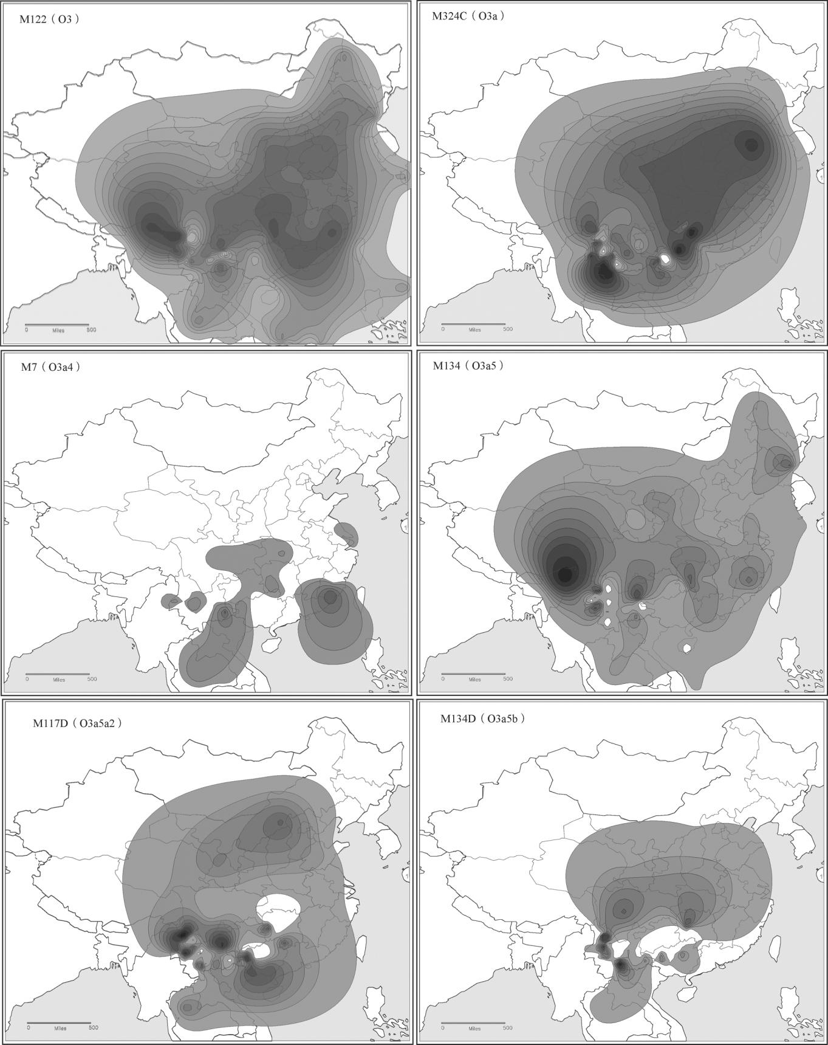
Hong Shi, 2005, although studied the origins of Chinese O3 DNA only in which India was not studied, yet its maps showed that the Chinese lineage had originated from the boarders of India.

Slide 111
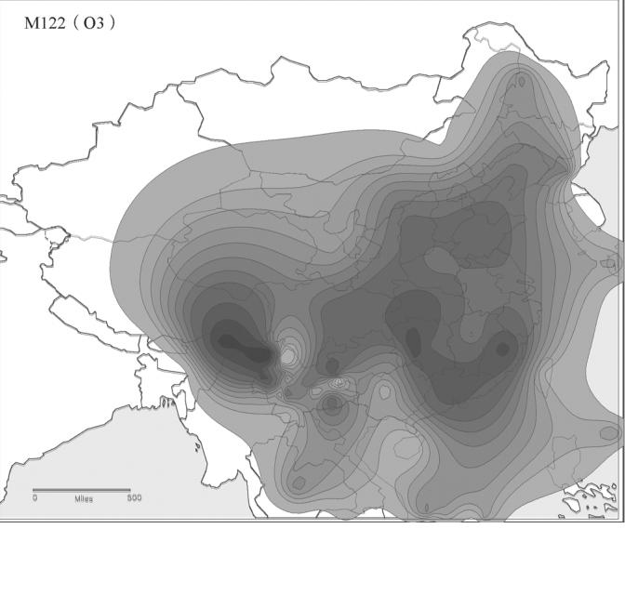
Hong Shi et al, 2005; China’s main male lineage O3 (Frequency map)

Slide 112
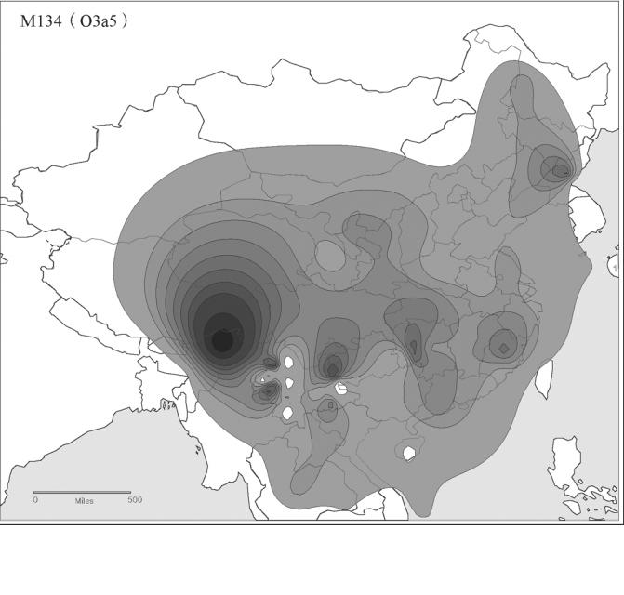

Slide 113
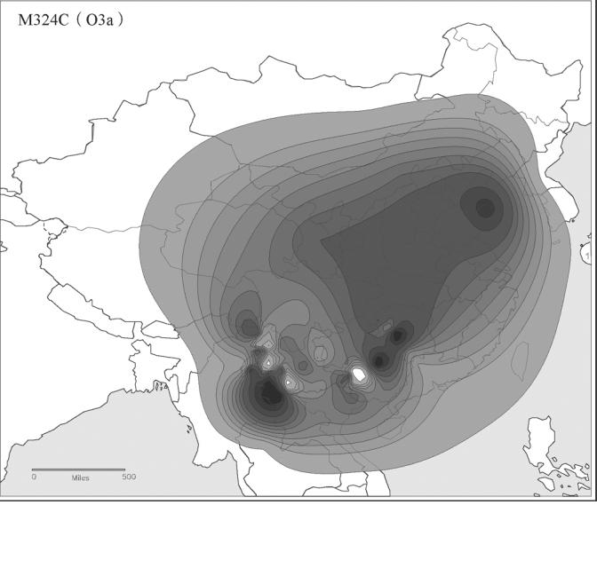

Slide 114
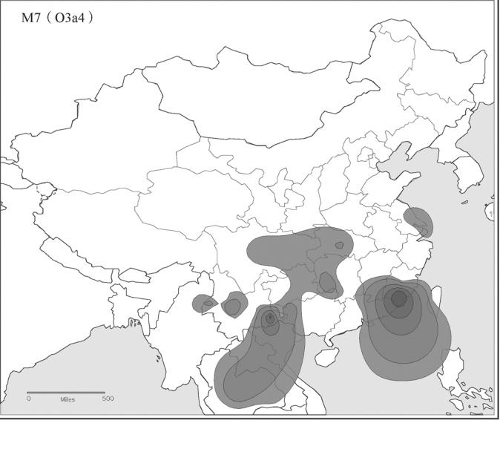

Slide 115
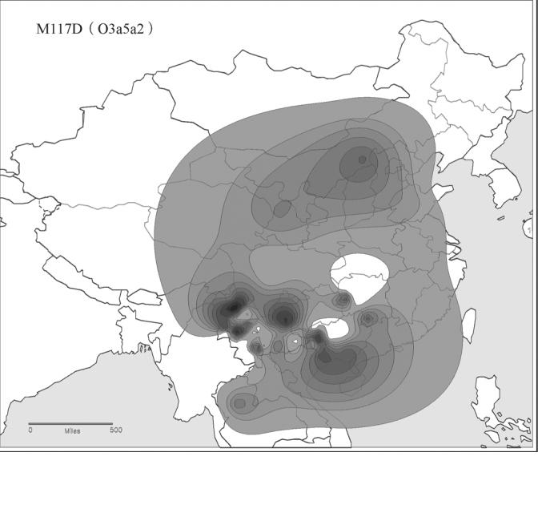

Slide 116
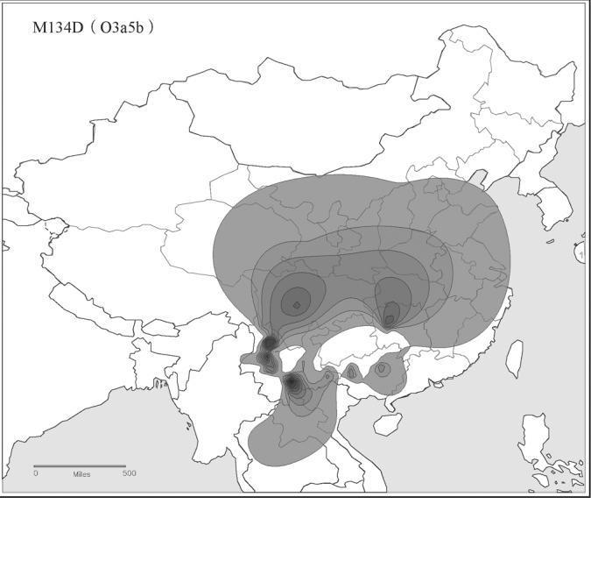

Slide 117
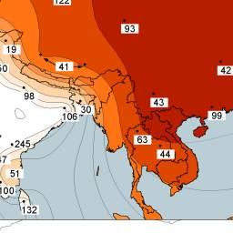
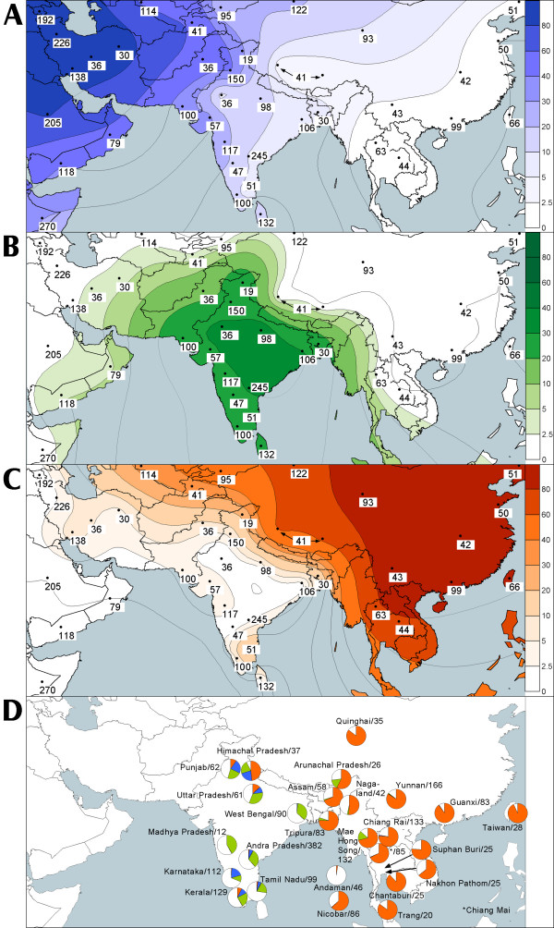
Metspalu, 2004, rightly had made the maps:

Slide 118
Aryan Invasion DNA Theory

Slide 119
Wells 2001, made a claim that Aryan marker male DNA, lineage R1a and R2, originated in Central Asia.
This gave a new lease of life to Aryan Invasion Theory. Later studies established that R1a and R2 originated in India.

Slide 120
Wells 2001-- and R1a confusion
Well’s theory of Aryan Invasion was decisively ruled out by DNA studies by the following groups of workers in Genomics:
Oppenheimer 2003
Sahoo, Kivisild et al 2006
Sengupta et al 2006
Trivedi et al 2008
Sharma et al 2009
Underhill et al2009

Slide 121
R1a-M17 and R2 both originated in India--Underhill, 2009; Sharma, 2009; Sahoo, 2006; Sengupta, 2006.
Sharma, S. et al, The Indian origin of paternal haplogroup R1a1* substantiates the autochthonous origin of Brahmins and the caste system, Journal of Human Genetics 2009, 54: 47–55.
Underhill, P. et al, The phylogeography of Y chromosome binary haplotypes and the origins of modern human populations, Ann. Hum. Genet. 2001, 65:43-62. Fig. 2, p. 47.

Slide 122
Sahoo, Sanghmitra et al, A prehistory of Indian Y chromosomes: Evaluating demic diffusion scenarios, PNAS 2006 Jan., 103(4): 843-848.
Sengupta, S. et al, Polarity and Temporality of High-Resolution Y-Chromosome Distributions in India Identify Both Indigenous and Exogenous Expansions and Reveal Minor Genetic Influence of Central Asian Pastoralists, Am J Hum Genet 2006 Feb., 78(2): 202–221.

Slide 123
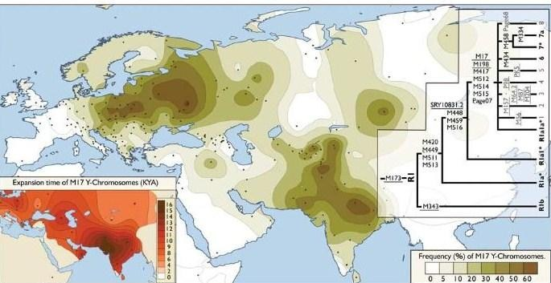
Underhill, 2009 showed that Aryan male lineage R1a originated in India 16,000 years back.

Slide 124
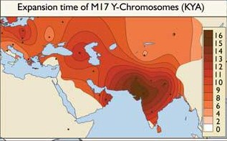
Underhill 2009 also gave age of R1a in different areas

Slide 125

Another controversy is about original Neolithic first farmer DNA.
It was claimed that J2 originated in Anatolia and from there dispersed to Europe (with Indo-European language), and to India with farming and Dravidian language.
Another DNA, L1 which was found in India and West Asia was claimed to be a marker of Dravidian arrival from Elam to India.

Slide 126
Farmer DNAs are of Indian origin
Sengupta et al 2006 found by appropriate DNA test that L1 and J2 are Indian in origin.
J2b2, a sub-branch of J2 originated in UP near Lucknow, about 14,000 years back. Hence J2 must be much older in India.
J2b reached Anatolia in 8,500 BP and Balkans in 4,000 ybp.

Slide 127
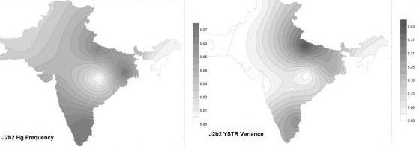
Sengupta, 2006; J2b2 distribution and origin maps

Slide 128
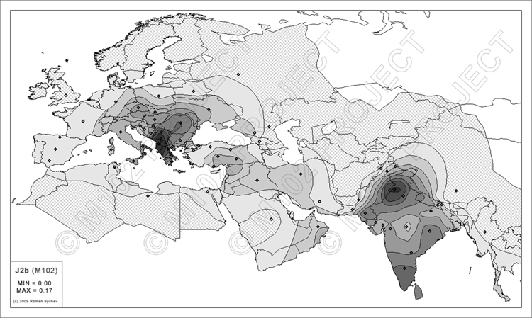

Slide 129
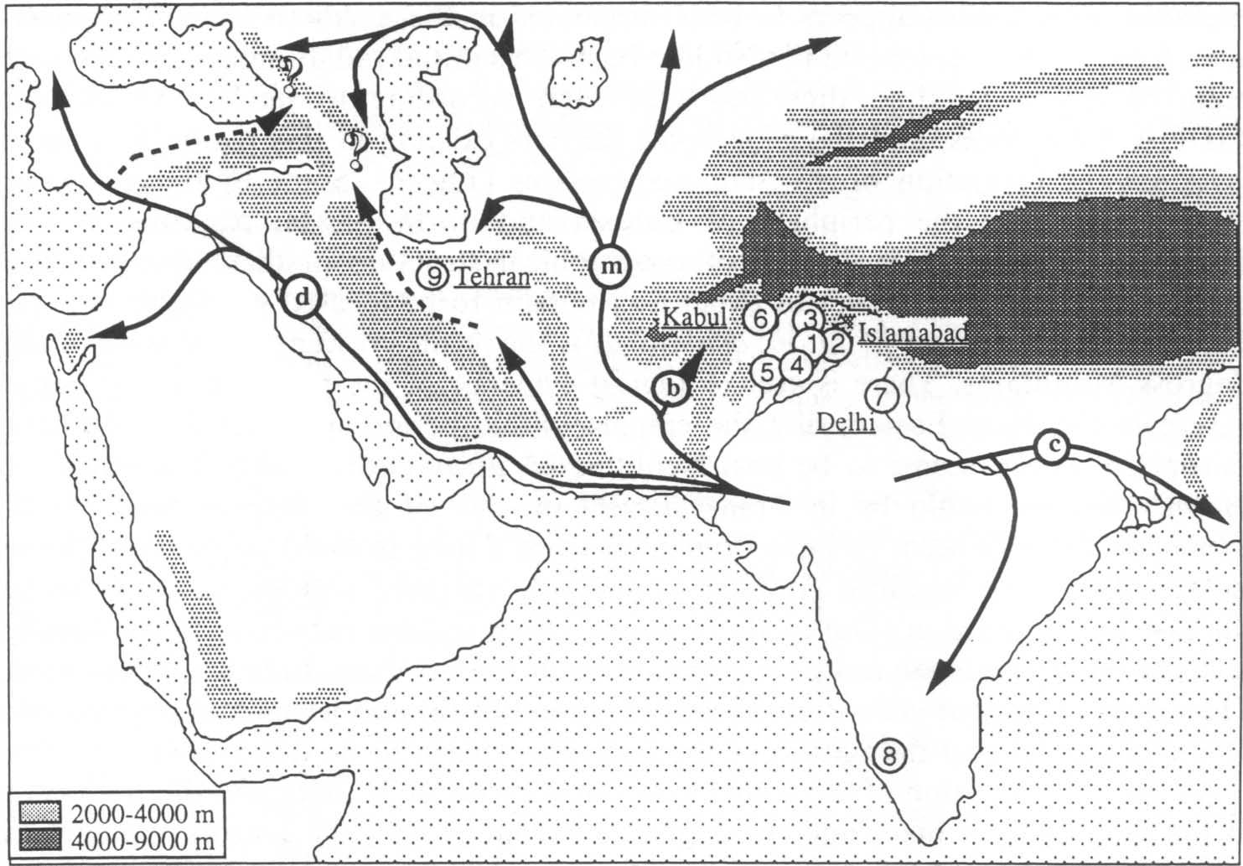
Boursot

Slide 130
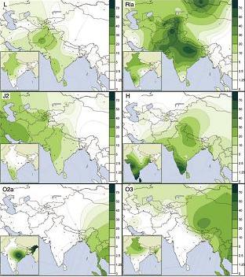
Sahoo et al 2006

Slide 131
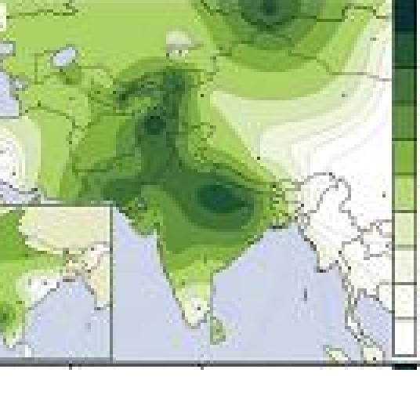
R1a male lineage. Note particular density in Ganga Valley
Sahoo et al, 2006

Slide 132
Similarly, theory of Dravidian arrival into India (L1, J2) or from Africa (K2, H1) etc have been ruled out by further detailed studies of these DNAs (Sahoo, 2006; Sengupta, 2006; Trivedi, 2008).
I am forced to conclude by the facts that Last Glacial Maximum imposed restrictions to human movements within India, promoting evolving of 3 language families

Slide 133
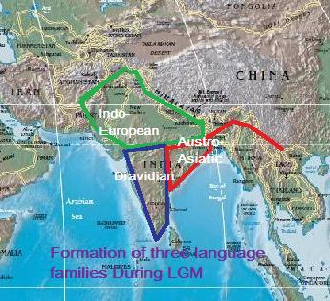
Evolution of modern Indian Languages in India
There was enough climatic barrier in India during LGM (Petraglia, 2005).
Isolation of Indian people into three groups led to linguistic differentiation over time, and three language families emerged after LGM, from the common Mesolithic language family of India. There is no other way to explain these findings.

Slide 134
Study of cattle and domesticated animals

Slide 135
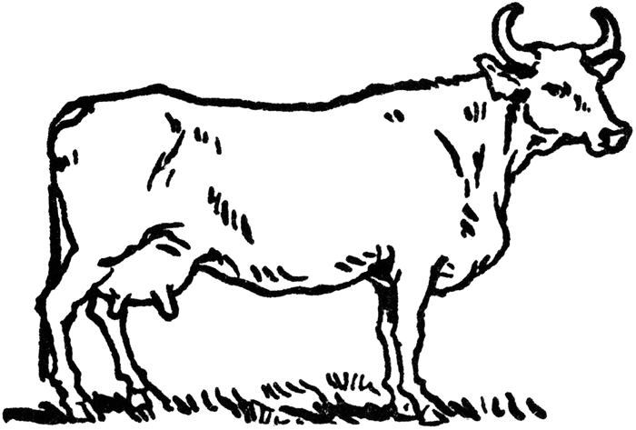
The First cow was domesticated in India, 45,000 years back
Evidence
from
DNA Study of
Domesticated
Cows

Slide 136
Earlier, many authors had said:
Cow was domesticated first in West Asia from where it migrated to India. (Epstein, H. & Mason, I. L., in Evolution of Domesticated Animals, ed. Mason, I. L., Longman, New York, 1984, pp. 6-27.)
But Loftus (1994) found that Indian cow had been domesticated independently of West Asian influence.

Slide 137
There are two types of cows in the world: taurine (Europe, west Asia, China), and Zebu or Indica (India, Africa, Southeast Asia and South China, sporadically in Europe, Central Asia, West Asia)
Chen (2009) proved by DNA studies that all the Zebus all over world have migrated from India, and Zebu had been domesticated only in North India.
[Chen, S. et al; Zebu cattle are an exclusive legacy of the South Asian Neolithic, Molecular Biology and Evolution, Sept 21, 2009]

Slide 138
Domesticated Indian zebu was central to catalyzing cow domestication in other parts of the world
Zebu genes are present in most of the taurine cow lineages of Europe, West Asia, Africa, Central Asia, China and Southeast Asia.
[Jann, Oliver C. et al, Geographic distribution of haplotype diversity at the bovine casein locus, Genetics selection evolution 2004, 36(2):243-257.]
[Ibeagha-Awemu, E. M. et al, Molecular Characterization of Bovine CSN1S2*B and Extensive Distribution of Zebu-Specific Milk Protein Alleles in European Cattle, Journal of Dairy Sciences 2007, 90:3522-3529.]

Slide 139

Map of distribution of DNA of Indian cows: hatched area represents hybrid of Indian with local cows

Slide 140

Indian cow dispersal to Africa by sea route implying sea-trade:

Slide 141
Linguistic evidence also supports it
English ‘cow’
Sanskrit: go
German: kuhe
This is expected. But --
Chinese: gu (Pinyin), ngau (Cantonese)
Thai : Koh
Bantu African : gombe
mean migration of cattle-rearing from India.

Slide 142

Mouse Migration: from India to rest of the world Bonhomme et al 2007, Genome Biol

Slide 143
Following species of mice and rats have been studied so far. And all of them have been found to have originated from India.
Black Rat (Rattus rattus)
Bandicoot-rat, Bandicota bengalensis, a noted rice-field pest in Indonesia originated in Mahanadi delta in association with buffalo
Mus caroli, Mus cervicolor and Rattus argentiventer are widely distributed in Mainland Southeast Asia north of the Malay Peninsula; their distributions are spotty in the archipelago and invariably restricted to wet rice growing areas.
Mus dunni, a small mice, native of northeast India and Rattus nitidus, a native of Nepal, are ricefield pests of Indonesia.

Slide 144
Water buffalo, considered essential for early rice cultivation (Bellwood), was domesticated in India.
Groves, C. P., “Domesticated and Commensal Mammals of Austronesia and Their Histories”, in Bellwood, P., Fox, J. and Tryon, D., The Austronesians: Historical and Comparative Perspectives, 1995.
Kumar, Satish et al, Phylogenography and domestication of Indian river buffalo, BMC Evolutionary Biology 2007, 7:186,

Slide 145
Barley was domesticated for the first time in India, although later another breed was domesticated independently in West Asia.
Jones, Huw et al; “Population-Based resequencing reveals that the flowering time adaptation of cultivated barley Originated east of fertile crescent”, Molecular Biology and Evolution, 2008, Vol 25, Number 10, pp. 2211-2219.

Slide 146
Rice domesticated for the first time in India: Oryza sativa indica; DNA evidence
Hiroko, Y. et al, “Molecular and Evolutionary analysis of the Hd6 Photoperiod Sensitivity Gene Within Genus Oryza”, in Rice 2009, 2:56-66.
Lonedo J. P. et al; “Phylogenography of Asian wild rice, Oryza rufipogen, reveals multiple independent domestications of cultivated rice oryza sativa”, Proc. Of National Acad. Of Sc. USA, 2006, 103, 9578-5983.
Chen, et al; “Distribution of deletion type in CpDNA of cultivated and wild rice”, in Japanese Journal of Genetics, 2003, 68: 597-603.
Harris, David; “The Multi-disciplinary Study of Agricultural Origins: ‘One World Archeology’ in Practice”, in The Future for Archeology, edited by Layton, Robert et al, Routledge Cavendish, 2006, p. 238.
Sweeny, Megan and McCouch, Susan; “The complex history of the domestication of rice”, Annals of Botany, 2007, 100 (5), pp. 951-957.

Slide 147
These studies enable us to push dates of Indian archaeology much back, as has been attempted by Petraglia.

Slide 148

Lahuradewa: Rice

Slide 149
Koldihwa--Sharma GR. 1985. Lahuradewa--Tewari , R et al. 2006. Jhusi--Dikshit, 2009.
Thus first cultivation (rice) also done at Ganga Valley at 10,000 ybp.
First pottery was made in India: 10,000 years back at Koldihwa, Jhusi and Lahuradewa.

Slide 150

Lahuradewa : Vase

Slide 151
Some less well known newer archaeological facts

Slide 152

In light of DNA findings, we need to rethink Indian history. We need to weigh seriously views of Kennedy, who found that Hathnora skull was a Homo sapiens

Slide 153

Nor should we ignore 160,000 years old pediatric perfectly Homo sapiens skull found near Madras: Rajendran et al, 2006, Ancient Asia.

Slide 154

Many things are yet to be incorporated in human story

Slide 155
Archaeological findings prove two things more:
First copper was made in India 9000 years back
First cotton was spun in India, 9000 years back

Slide 156

9000 years old Cotton thread in Copper Bead

Slide 157

Drilling treatment of teeth: 8000 years old, Mehrgarh

Slide 158


Slide 159
And that the robust human skeletons of Sarai Nahar Rai (Mesolithic) actually belonged to a colder period i.e. before 16,000 BP (Kennedy, 2008)
And that Indian Mesolithic (Microlithic) started in 35,000 years back, earlier than anywhere else: Petraglia, 2009a. James and Petraglia 2005

Slide 160
And Petraglia’s findings from Jwalapuram in Kurnool Dist, Andhra Pradesh--that there has been a cultural continuity in India over last 100,000 years or more: Petraglia, 2007, 2009b.
These show that the time to rewrite history has arrived.
Thank You

